Slide 1
The Independent-Samples t Test
Chapter 11

Slide 2
Quick Test Reminder
One person = z score
One sample with population standard deviation = z test
One sample no population standard deviation = single t-test
One sample test twice = paired samples t-test

Slide 3
Independent Samples t-Test
Used to compare two means in a between-groups design (i.e., each participant is in only one condition)
Remember that dependent t (paired samples) is a repeated measures or within-groups design

Slide 4
Between groups design
In between groups, your sets of participants’ scores (i.e. group 1 versus group 2) have to be independent
Remember independence is the assumption that my scores are completely unrelated to your scores

Slide 5
Quick Distributions Reminder
z = Distribution of scores
z = distribution of means (for samples)
t = distribution of means (for samples with estimated standard deviation)
t = distribution of mean differences between paired scores (for paired samples with estimated standard deviation)
t = distribution of differences between means (for two groups independent t)

Slide 6
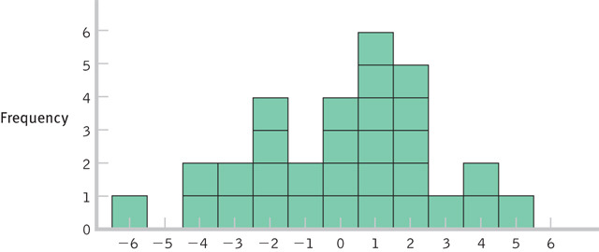
Distribution of Differences Between Means
Notes:
Mean 1 – Mean 2

Slide 7
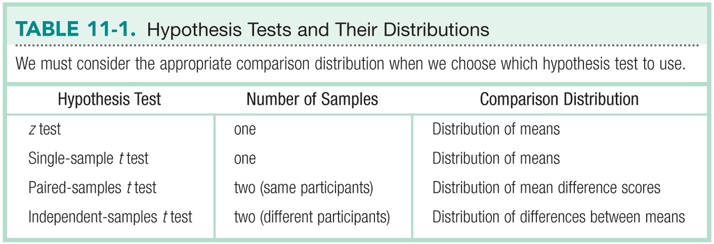
Hypothesis Tests & Distributions
Notes:
**paired-samples t =

Slide 8
Let’s talk about Standard Deviation
Test | Standard Deviation | Standard deviation of distribution of … (standard error)
Z | σ (population) | σ_{M}
Single t | s (sample) | s_{M}
Paired t | s (sample on difference scores) | s_{M}
Independent t | s group 1 s group 2 s_{pooled} | s_{difference}

Slide 9
Let’s talk about Standard Deviation
This section is for independent t only
Notes:
Variance = same for all tests, but paired t is on difference scores
Square root of variance = standard deviation
SE = s pooled/N for that group

Slide 10
Let’s talk about test statistics
Test type | Formula
Z | M – μ_{M} σ_{M}
Single t | M – μ_{M} s_{M}
Paired t | M_{difference} s_{M}
Independent t | M – M s_{difference}

Slide 11
Let’s talk about df
Test type | df
Single sample | N – 1
Paired samples t | N – 1
Independent t | N – 1 + N – 1

Slide 12
Steps for Calculating Independent Sample t Tests
Step 1: Identify the populations, distribution, and assumptions
Step 2: State the null and research hypotheses
Step 3: Determine the characteristics of the comparison distribution
Step 4: Determine critical values, or cutoffs
Step 5: Calculate the test statistic
Step 6: Make a decision

Slide 13
Let’s work some examples!
Let’s work some examples: chapter 11 docx on blackboard.

Slide 14
Assumptions
Assumption | Solution
Normal distribution | N ≥ 30
DV is scale | Nothing… do non-parametrics
Random selection (sampling) | Random assignment to group

Slide 15
Step 2
List the sample, population, and hypotheses
Sample: group 1 versus group 2
Population: those groups mean difference will be 0 (μ – μ = 0)

Slide 16
Step 2
Now, we can list those as group 1 versus group 2 in our Research and Null Hypotheses
Should also help us distinguish between independent t and dependent t
Research: group 1 ≠ OR > OR < group 2
Null: group 1 = OR ≤ OR ≥ group 2
Watch the order!

Slide 17
Step 3
List the descriptive statistics
 | Group 1 | Group 2
Mean
SD
N
df
S difference
Notes:
**get s difference by clicking location parameter

Slide 18
Step 4
Since we are dealing with two groups, we have two df … but the t distribution only has one df?
So add them together!
df total = (N-1) + (N-1)

Slide 19
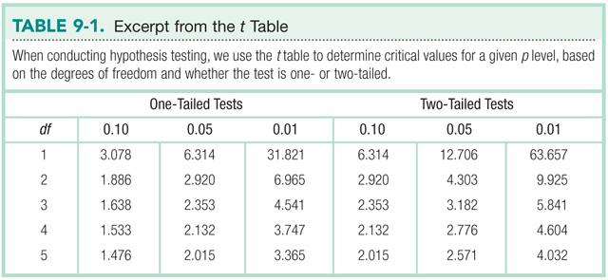
Step 4
Figure out the cut off score, t_{critical}
Notes:
**May also be .01 – remember to read the problem.

Slide 20
Step 5
Find t_{actual}
t = (M_{X} – M_{Y}) / Se_{diff}
Make sure your mean difference score, df, and hypothesis all match!

Slide 21
Step 6
Compare step 4 and 5 – is your score more extreme?
Reject the null
Compare step 4 and 5 – is your score closer to the middle?
Fail to reject the null

Slide 22
Steps for Calculating CIs
The suggestion for CI for independent t is to calculate the CI around the mean difference (M_{X} – M_{Y}).
This calculation will tell you if you should reject the null – remember you do NOT want it to include 0.
Does not match what people normally do in research papers (which is calculate each M CI separately).
Notes:
Location parameter = CI of mean difference

Slide 23
Confidence Interval
Lower limit= M_{difference} – t_{critical}*SE
Upper limit= M_{difference} + t_{critical}*SE

Slide 24
Effect Size
Used to supplement hypothesis testing
Cohen’s d:

Slide 25
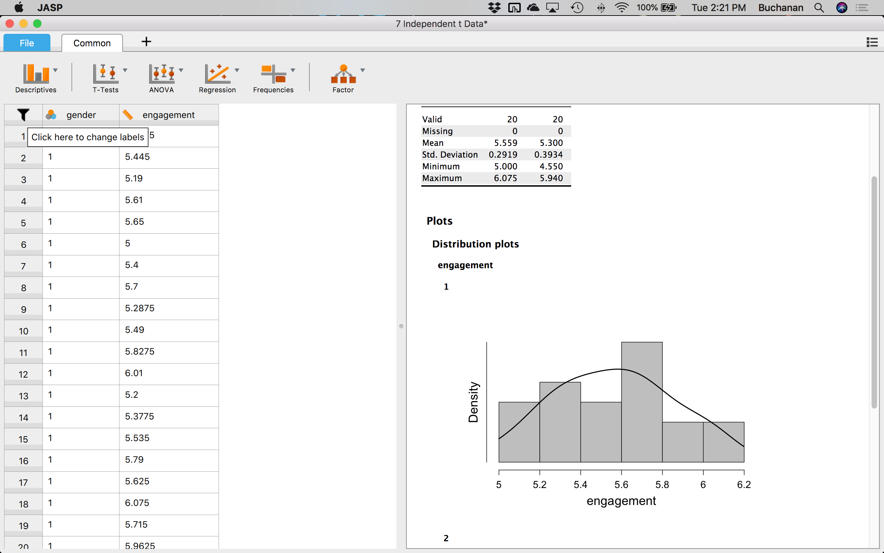
How to JASP
Quick note on changing labels:
After you have pulled up your data in JASP, if the labels shown for your categorical variable are numbers, we need to change that
If you hover over the variable column name, you will see a note saying “click here to change labels”. Click on it.

Slide 26
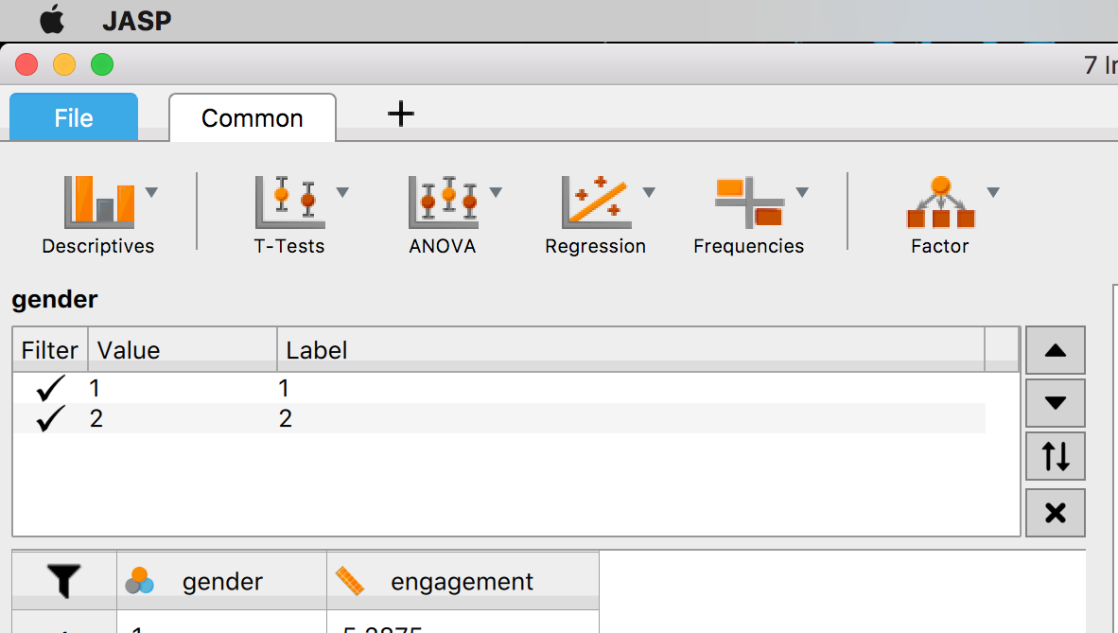
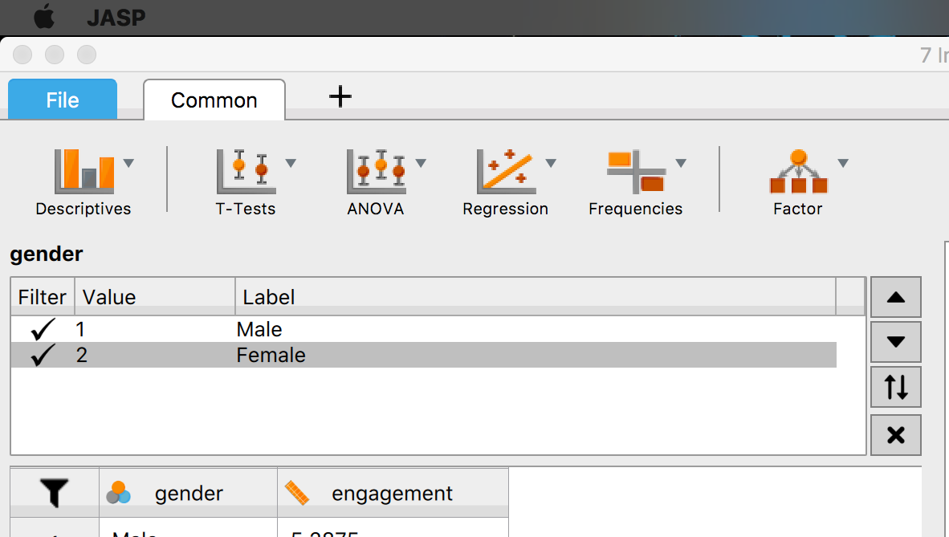
How to JASP
From the table it brings up, you can change the “Labels” by clicking on the current label and typing the label you want that number to be

Slide 27
How to JASP
Assumption:
You will check for outliers the same way, using the dependent variable
Normality will also be the same, just select the option for “Normality” under “Assumption checks” after you select which t test you are going to run
Something new: we will also select “Equality of Variances” under “Assumption checks”
This will give you results Levene’s test, which tests for the assumption of homogeneity

Slide 28
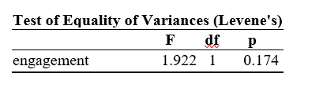
How to JASP
Levene’s test
For this test, if p < .05, you would not meet the assumption of homogeneity
If this happens you will have to use a correction for unequal variances (we’ll use the Welch correction)
If p > .05, you would meet the assumption
Woohoo!! You can read your output without the correction

Slide 29

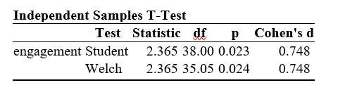
How to JASP
If you don’t meet the assumption of homogeneity, just select the “Welch” option under “Tests” and you will get a second line of output:

Slide 30
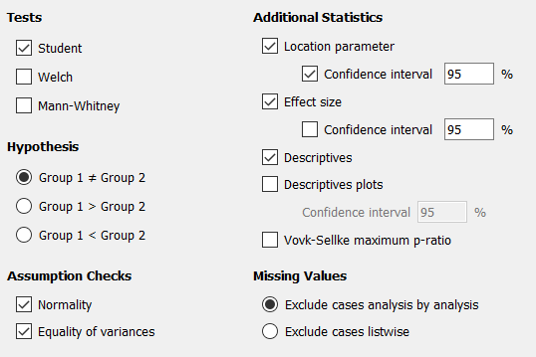
How to JASP
Everything else will be the same… yay!

Slide 31
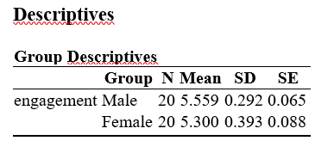
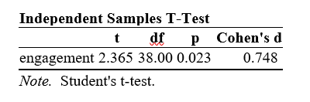
How to JASP
The advertisement was more engaging to male viewers (M = 5.56, SD = 0.35) than female viewers (M = 5.30, SD = 0.35), a large and significant difference, t(38) = 2.37, p = .023, d = 0.75.

